Slide 1
Chapter 8
Systems Development

Slide 2
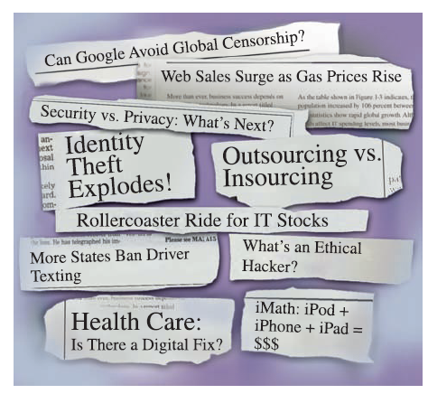
Introduction
Companies use information as a weapon in the battle to increase productivity, deliver quality products and services, maintain customer loyalty, and make sound decisions
Information technology can mean the difference between success and failure

Slide 3
Why Learn About Systems Development?
In this chapter:
You will see how you can initiate the systems development process
You will see how you can use the systems development approach to start your own business
You can be involved in designing and implementing an information system that will directly benefit you on the job

Slide 4
An Overview of Systems Development
In today’s businesses:
Managers and employees in all functional areas work together and use business information systems
Corporate and non profit organization use system development to achieve their goals
This chapter will:
Help you avoid systems development failures or projects that go over budget

Slide 5
Participants in Systems Development
Effective system development requires a team effort
Development team:
Determines objectives of the information system
Delivers system that meets objectives
Selecting the best IS team is critical to project success
Project:
Planned collection of activities that achieves a goal
Defined starting point and ending point

Slide 6
Participants in Systems Development (continued)
Project manager:
Responsible for coordinating all people and resources needed to complete a project on time
Users:
People who will interact with the system regularly
Systems analysts:
Professional who specializes in analyzing and designing business systems
Programmer:
Responsible for modifying or developing programs to satisfy user requirements

Slide 7
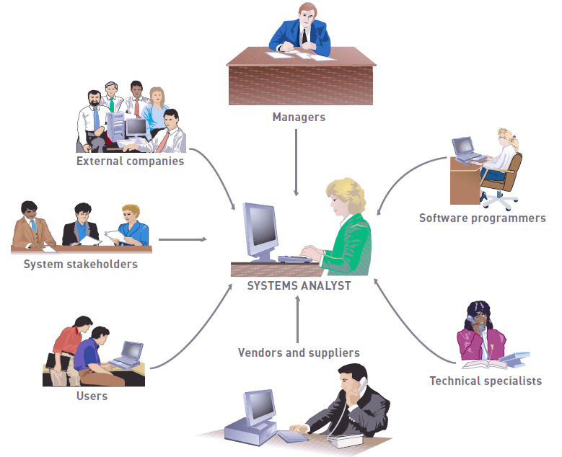
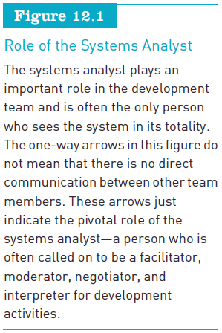
Participants in Systems Development (continued)

Slide 8
Initiating Systems Development
Systems development initiatives:
Arise from all levels of an organization
Can be planned or unplanned
Initiated for many reasons
Mergers and acquisitions can trigger many systems development projects

Slide 9
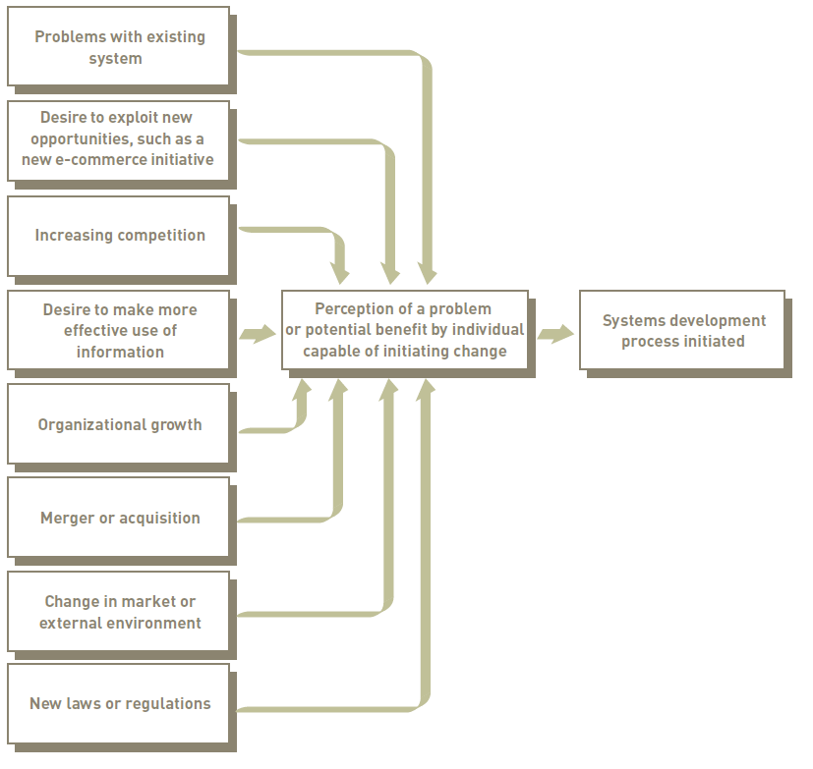
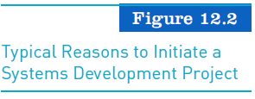
Initiating Systems Development (continued)

Slide 10
Understanding The Business
Business process management (BPM)
Variety of tools, methodologies to analyze, design, optimize processes
Used by firms to manage business process redesign
Steps in BPM
Identify processes for change.
Analyze existing processes.
Design the new process.
Implement the new process.
Continuous measurement.
Notes:
This slide emphasizes business process management, a category of tools and techniques that help firms redesign business processes, the riskiness of business process reengineering, and the need to properly manage it in order for BPR to be effective. Ask students what the importance is of each step. For example, why is it important to determine the right business process to change rather than all business processes (some processes may not yield time or cost savings, you could spend too much money trying to improve all processes, and some processes may already be effective). Give students an example of a business process and ask how the process could be measured. For example, how would you measure the business process of a customer ordering a meal? Of a kitchen preparing and delivering that meal? What about the business process of hiring a new employee? It is important to note that, even with effective process redesign, a majority of reengineering projects do not achieve breakthrough gains because of inadequate change management.

Slide 11
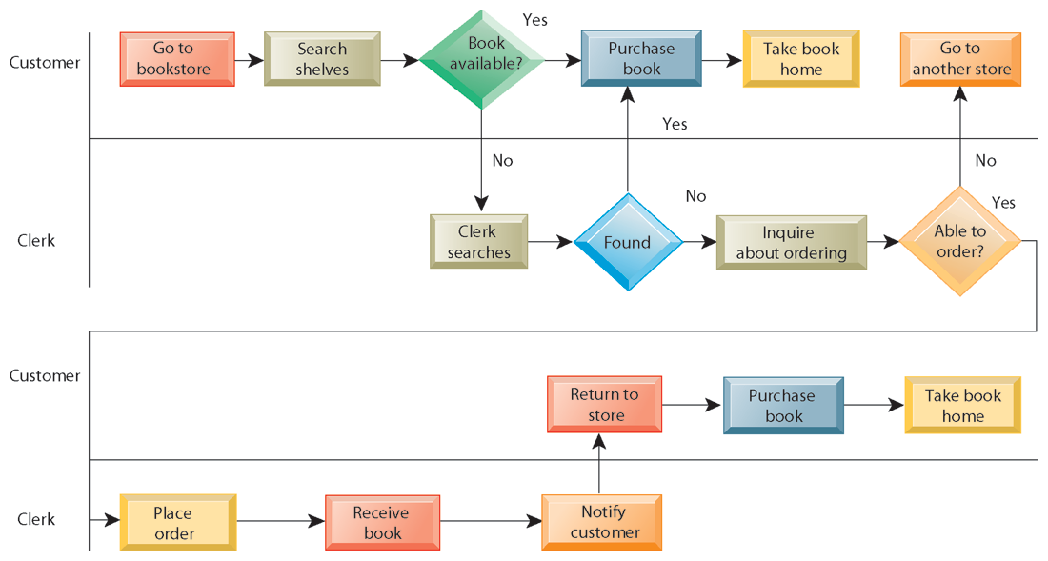
AS-IS BUSINESS PROCESS FOR PURCHASING A BOOK FROM A PHYSICAL BOOKSTORE
FIGURE 13-2
Purchasing a book from a physical bookstore requires many steps to be performed by both the seller and the customer.
Notes:
This slide’s graphic illustrates the process of purchasing a book prior to reengineering, including the steps if a book is not available. It emphasizes the sequential nature of the task. Besides the time taken for this process, what are other disadvantages of this traditional business process?

Slide 12
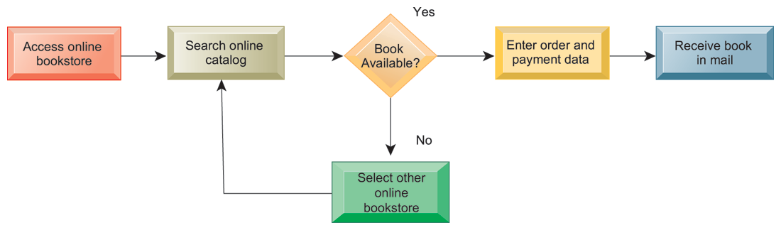
REDESIGNED PROCESS FOR PURCHASING A BOOK ONLINE
FIGURE 13-3
Using Internet technology makes it possible to redesign the process for purchasing a book so that it requires fewer steps and consumes fewer resources.
Notes:
This graphic illustrates the book purchasing process after reengineering as an online process. The new process and technology has reduced numerous stages to four or five. What are the elements that have allowed these steps to occur? Which of the four types of organizational change described earlier does this redesigned process most closely resemble—automation, rationalization, redesign, paradigm shift?

Slide 13
Systems Development Methodology
Most prominent methodologies for modeling and designing systems:
Structured methodologies
Object-oriented development
Structured methodologies
Structured: Techniques are step-by-step, progressive
Process-oriented: Focusing on modeling processes or actions that manipulate data
Separate data from processes
Notes:
This slide identifies the two most prominent methodologies for modeling systems and introduces the core concepts behind a structured methodology. Ask students what a process is or to give an example of a process. What does it mean to “separate data from processes”?

Slide 14
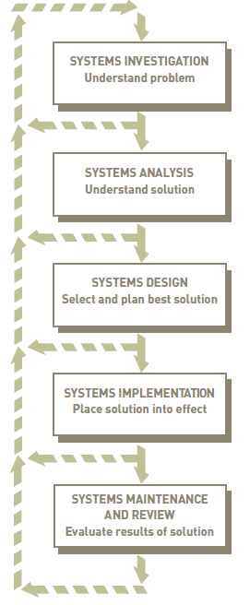
Structured
Systems development life cycle (SDLC)
Predictive approach
Uses a set of process models to describe a system graphically
Process-centered technique
Waterfall model
Notes:
This slide identifies the two most prominent methodologies for modeling systems and introduces the core concepts behind a structured methodology. Ask students what a process is or to give an example of a process. What does it mean to “separate data from processes”?

Slide 15
System Investigation
Analyze
System Request/Determine problem/Opportunity exist
Conduct a feasibility study
End -Product : Feasibility Study
Studies existing systems and work processes to identify strengths, weaknesses, and opportunities for improvement
End -Product : Functional Requirement
Design
Develop specification that satisfy functional requirements
Design on UI, data, process
End-Product : System Specification
Implementation
Acquire hardware and Software
Test the system, train people to use
End-product : Operational System
Maintenance
Monitor,evaluate and modify system as needed
End-Product : Improved System

Slide 16
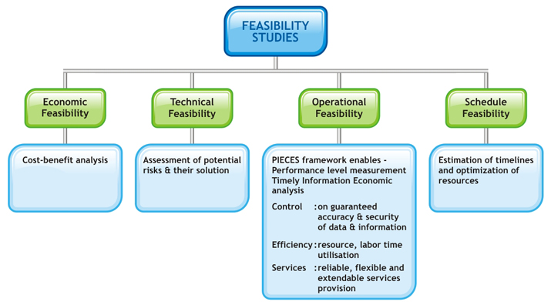

Slide 17
Structured
Data flow diagram (DFD):
Primary tool for representing system’s component processes and flow of data between them
Offers logical graphic model of information flow
High-level and lower-level diagrams can be used to break processes down into successive layers of detail
Data dictionary: Defines contents of data flows and data stores
Process specifications: Describe transformation occurring within lowest level of data flow diagrams
Structure chart: Top-down chart, showing each level of design, relationship to other levels, and place in overall design structure
Notes:
This slide continues the discussion of the structured methodology, looking at the tools and techniques that it uses to model an information system. An example data flow diagram is shown on the next slide, so it may be helpful to move to that slide to discuss these diagrams. A data dictionary is needed so that system builders know exactly what data is stored and manipulated. Process specifications express the logic that is used when one piece of data is transformed by a process. A structure chart looks at the main function of the system, breaks it down into subfunctions, breaks subfunctions into more detailed subfunctions, until the smallest level of detail is reached. Ask students to give an example of what the smallest level of detail might look like, for example, in a university system managing student grades and reports.

Slide 18
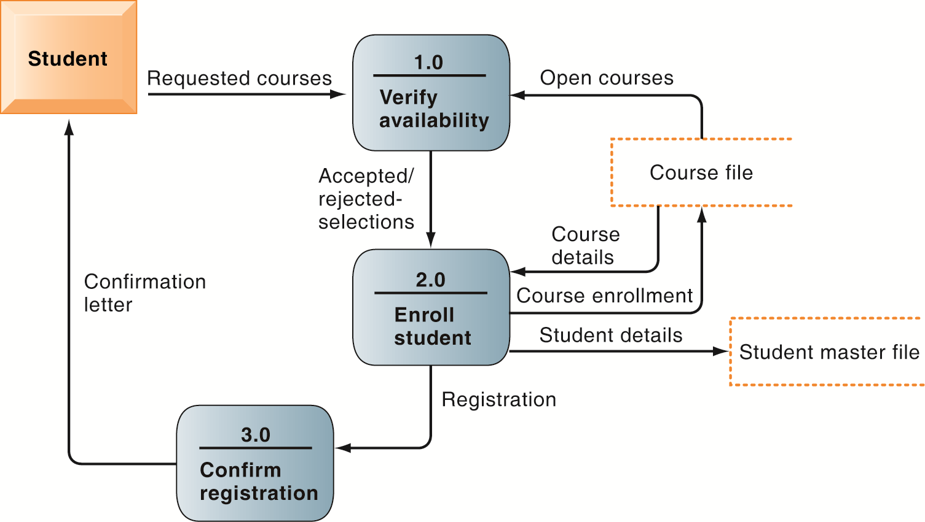
DATA FLOW DIAGRAM FOR MAIL-IN UNIVERSITY REGISTRATION SYSTEM
FIGURE 13-6
The system has three processes: Verify availability (1.0), Enroll student (2.0), and Confirm registration (3.0). The name and content of each of the data flows appear adjacent to each arrow. There is one external entity in this system: the student. There are two data stores: the student master file and the course file.
Notes:
This graphic is a data flow diagram. Ask students what the rounded boxes represent (processes) and what the square box represents (an external entity). What about the open rectangle and the arrows? Where does the process begin? Ask a student to step through the process of registering a student for a course, noting what data is transferred at each step. It’s always fun to do data flow diagrams as a group because it illustrates how the same process is seen differently by different people.

Slide 19
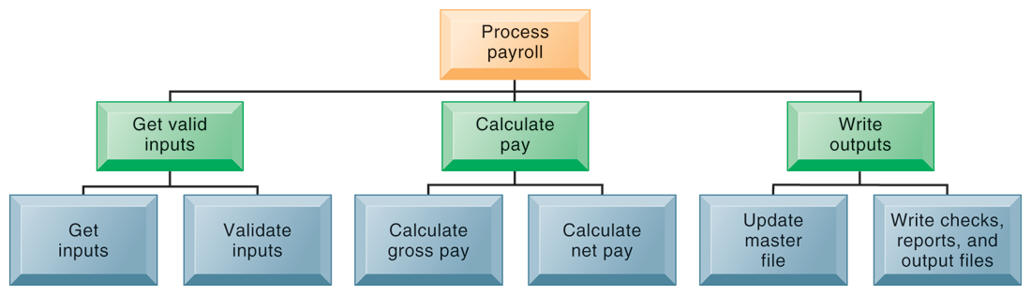
HIGH-LEVEL STRUCTURE CHART FOR A PAYROLL SYSTEM
FIGURE 13-7
This structure chart shows the highest or most abstract level of design for a payroll system, providing an overview of the entire system.
Notes:
This graphic shows a high-level structure chart. Note that this is high-level—and subfunctions exist for the functions “Get inputs,” “Validate inputs,” and so on. What might be a subfunction for “Calculate gross pay”?

Slide 20
Object Oriented
Object-oriented development
Object is basic unit of systems analysis and design
Object:
Combines data and the processes that operate on those data
Data encapsulated in object can be accessed and modified only by operations, or methods, associated with that object
Object-oriented modeling based on concepts of class and inheritance
Objects belong to a certain class and have features of that class
May inherit structures and behaviors of a more general, ancestor class
Notes:
This slide introduces the second of the two main system modeling methodologies—object-oriented development. A key concept here is that of class and inheritance. Ask students what a class is (general category of similar objects) and to describe objects that might be in the same class. For example, what objects might be in the category “Degrees” in a university’s information system?

Slide 21
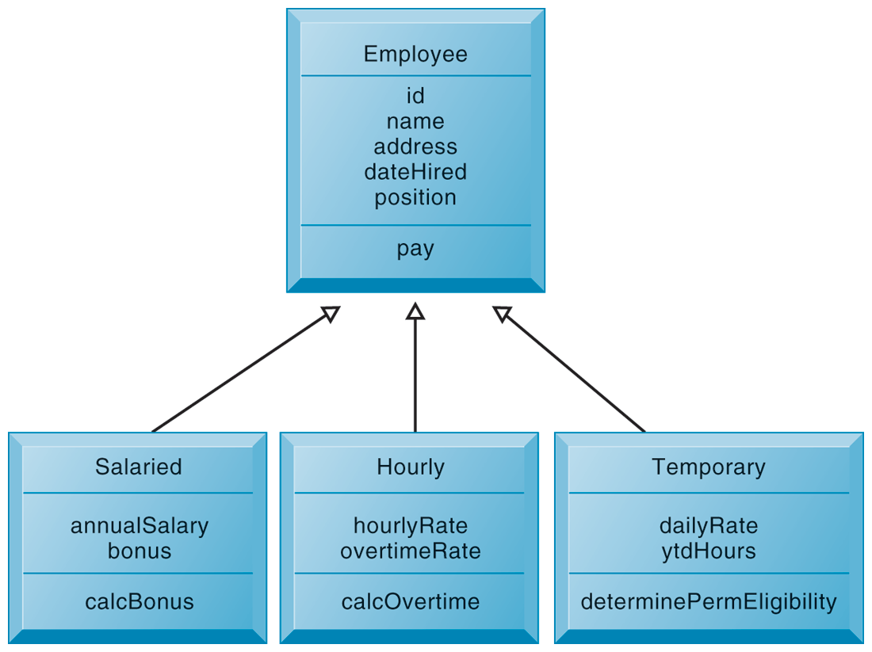
CLASS AND INHERITANCE
This figure illustrates how classes inherit the common features of their superclass.
FIGURE 13-8
Notes:
This graphic illustrates the concept of class and inheritance in object-oriented development. The Class employee allows subclasses to be created using the “template” or superclass “Employee” and use the processes and properties defined for Employee. Subclasses can use properties of their superclass and also add their own properties. If a subclass “Intern” was added to this chart, what unique properties might it have?

Slide 22
Object Oriented
Object-oriented development
More iterative and incremental than traditional structured development
Systems analysis: Interactions between system and users analyzed to identify objects
Design phase: Describes how objects will behave and interact; grouped into classes, subclasses, and hierarchies
Implementation: Some classes may be reused from existing library of classes, others created or inherited
Because objects reusable, object-oriented development can potentially reduce time and cost of development
Notes:
This slide continues the discussion of object-oriented development, highlighting unique considerations during the systems development process. Ask students to perform some rudimentary systems analysis and design for an information system that managed inventory for a department store. What classes might be created? What properties would they have? What subclasses would there be for one of these classes and what properties would they inherit?
It is important to emphasize that object-oriented development can reduce the time and cost of development through reusing objects and classes from one application for other applications.

Slide 23
System Development Alternatives
Traditional systems life cycle
Prototyping
End-user development
Application software packages
Outsourcing
Notes:
Structured methodology and object-oriented development describe the structure of the software applications used by information systems. The next slides discuss different ways in which the work by the teams involved in creating this software can be organized.
Ask students to evaluate which of these methods, if implemented effectively, they think might produce the highest ROI. Which might be the riskiest?

Slide 24
System Development Alternatives
Traditional systems life cycle:
Oldest method for building information systems
Phased approach:
Development divided into formal stages - SDLC
“Waterfall” approach: One stage finishes before next stage begins
Formal division of labor between end users and information systems specialists
Emphasizes formal specifications and paperwork
Still used for building large complex systems
Can be costly, time-consuming, and inflexible
Notes:
This slide describes the first method for building systems, the traditional systems life cycle. Ask students what the effects of unanticipated user requirements are when using this type of building method. What is the role of end users in this method? What happens when users change their minds halfway through the project? Can the systems analysis be started over?

Slide 25
System Development Alternatives
Prototyping
Building experimental system rapidly and inexpensively for end users to evaluate
Prototype: Working but preliminary version of information system
Approved prototype serves as template for final system
Steps in prototyping
Identify user requirements.
Develop initial prototype.
Use prototype.
Revise and enhance prototype.
Notes:
This slide discusses the second method of systems building, prototyping. It is an explicitly iterative process. The term iterative has been used several times; ask students to describe what this means (steps to build the system can be repeated over and over). What are the benefits of an iterative process?
Note that once no more iterations are needed, the prototype becomes the finished specifications for the final application, or may serve as the production version of the application.

Slide 26
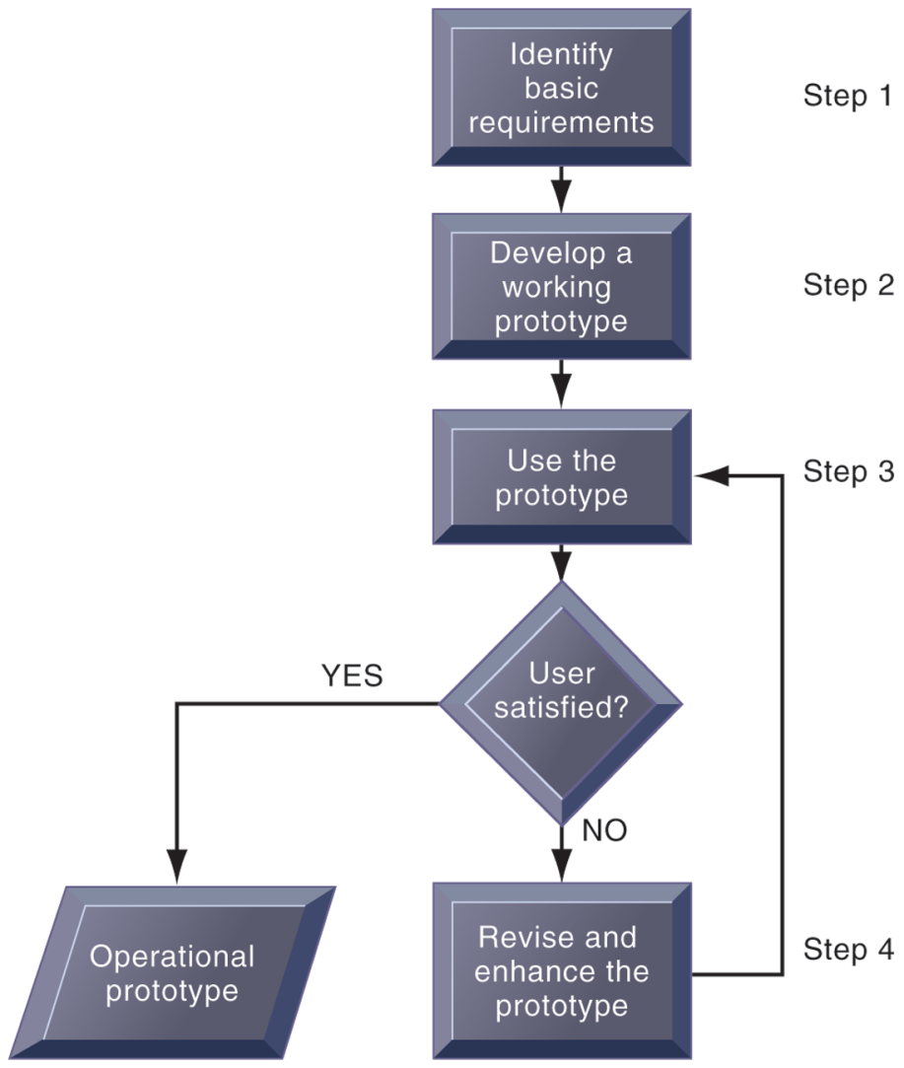
THE PROTOTYPING PROCESS
The process of developing a prototype can be broken down into four steps. Because a prototype can be developed quickly and inexpensively, systems builders can go through several iterations, repeating steps 3 and 4, to refine and enhance the prototype before arriving at the final operational one.
FIGURE 13-9
Notes:
This graphic illustrates the four steps (rectangles) of prototyping. The steps that are repeated are steps 3) use the prototype and 4) revise and enhance the prototype. Would this type of system development be appropriate for developing a large, enterprise management system?

Slide 27
System Development Alternatives
Advantages of prototyping
Useful if some uncertainty in requirements or design solutions
Often used for end-user interface design
More likely to fulfill end-user requirements
Disadvantages
May gloss over essential steps
May not accommodate large quantities of data or large number of users
May not undergo full testing or documentation
Notes:
This slide continues the discussion of prototyping, listing the advantages and disadvantages to using this method of building systems.
Ask students to explain these advantages and disadvantages. For example, why is prototyping useful if there is uncertainty in requirements? What kinds of essential steps might be glossed over?

Slide 28
System Development Alternatives
End-user development:
Allows end users to develop simple information systems with little or no help from technical specialists
Reduces time and steps required to produce finished application
Tools include
User friendly query languages and reporting
PC software tools

Slide 29
System Development Alternatives
End-user development (cont.):
Advantages:
More rapid completion of projects
High level of user involvement and satisfaction
Disadvantages:
Not designed for processing-intensive applications
Inadequate management and control, testing, documentation
Loss of control over data
Managing end-user development
Require cost-justification of end-user system projects
Establish hardware, software, and quality standards
Notes:
This slide continues the discussion of end-user development. What types of projects might end-user development be most suited for? How might this type of development result in a loss of control over data?

Slide 30
System Development Alternatives
Application software packages
Save time and money
Many offer customization features:
Software can be modified to meet unique requirements without destroying integrity of package software
Evaluation criteria for systems analysis include:
Functions provided by the package, flexibility, user friendliness, hardware and software resources, database requirements, installation and maintenance efforts, documentation, vendor quality, and cost
Request for Proposal (RFP)
Detailed list of questions submitted to packaged-software vendors
Used to evaluate alternative software packages
Notes:
This slide discusses a fourth alternative in systems building, the use of application software packages. It is important to note that many functions are common to all business organizations—payroll, accounts receivable, or inventory control. Software packages will fulfill the need for many organizations for these types of functions. However, it is still important to perform systems analysis in order to determine your organization’s requirements for a system. Step through and explain (or have students explain) the evaluation criteria for a package. For example, you would want to outline the functions you need from the package and determine whether the software package provides that.

Slide 31
System Development Alternatives
Outsourcing
Several types
Cloud and SaaS providers
Subscribing companies use software and computer hardware provided by vendors
External vendors
Hired to design, create software
Domestic outsourcing
Driven by firms need for additional skills, resources, assets
Offshore outsourcing
Driven by cost-savings
Notes:
This slide describes a fifth alternative in systems building—outsourcing. SaaS and cloud computing were introduced in Chapter 5. Have students describe these types of outsourcing in their own words. Refer students to the Learning Tracks on outsourcing and cloud computing.

Slide 32
System Development Alternatives
Outsourcing (cont.)
Advantages
Allows organization flexibility in IT needs
Disadvantages
Hidden costs, for example:
Identifying and selecting vendor
Transitioning to vendor
Opening up proprietary business processes to third party
Notes:
This slide continues the discussion of outsourcing. It is important to emphasize the amount of work involved in partnering and sharing work with a vendor. It may take anywhere from three months to a year to fully transfer work to a vendor. What other types of hidden costs can students identify?

Slide 33
Systems Development Guidelines
Develop a project plan
Involve users and listen carefully to them
Use project management tools to identify tasks and milestones
Develop accurate cost and benefit information
Remain flexible

